Slide 1





Autonomous Visual Navigation Challenge – Round 1 Proposal
WarehouseNav AMR
Autonomous GPS-Denied Indoor Navigation for Warehouse Inventory Management
From Navigation to Intelligent Interaction
Team Proposal Presentation
Perception-to-Control Pipeline using ROS2 & Gazebo
Challenge Track: Robotics | Industry Partner: ARTPARK, IISc | Deadline: 26 March 2026

Slide 2
Proposal & Team Details
Field | Details
Proposal Title | WarehouseNav AMR:Intelligent Navigation and Pick-and-Place in GPS-Denied Warehouse Environments
Team Name | Lumi
Team Lead | Nandanaa M S | Email: nandanaams555@gmail.com | Reva University
Challenge Track | Robotics
Industry Partner | ARTPARK, AI & Robotics Technology Park @ IISc
Submission Deadline | 26 March 2026
Final Round | 17–19 April 2026 — MIT Bengaluru Campus

Slide 3
Team Members, Affiliation & Expertise
Member 1
Reva University
Nandanaa M S
Expertise: ROS2, Nav2, SLAM, Sensor Fusion, Autonomous Navigation
Member 2
SRM University
Lohith M R
Expertise: ROS2, CAD Design, Computer Vision, YOLOv8, OpenCV, Perception Pipelines
Member 3
GMIT College
Nithin Kumar M
Expertise: Python, Open CV, HTML, JAVA
Member 4
GMIT College
Sudarshan D T
Expertise: C++, Embedded C

Slide 4
Understanding of the Problem Statement
Warehouses are GPS-denied environments. Concrete walls + metal shelving block ALL satellite signals — standard robot positioning fails completely.
The Problem
Key Challenges (from ARTPARK framework)
Perception
No GPS signal indoors — concrete walls block satellites entirely
Current AMRs need fixed infrastructure (QR grids, magnetic strips)
Costs ₹10–50L to deploy fixed navigation infrastructure
Layout changes break pre-built maps — full remapping required
Static AMRs freeze when humans or forklifts cross their path
Build real-time map using only onboard sensors
Decision-Making
Collision-free planning in dynamic aisles
Control
Smooth differential-drive from high-level waypoints
Simulation assumptions: Flat warehouse floor | 2D LiDAR sufficient | No multi-floor navigation | Differential-drive robot | Known start pose

Slide 5
Proposed Solution – High Level Architecture
Differential-drive AMR: camera + LiDAR → SLAM → Nav2 MPPI → autonomous warehouse navigation. Zero fixed infrastructure.
RPLiDAR A1
360°, 10 Hz
IMU MPU-9250
100 Hz, 6-DOF
Wheel Encoders
Odometry, 50Hz
USB Camera
640×480, 30fps
SENSORS
slam_toolbox
Live occupancy map
EKF Fusion
robot_localization
Nav2 Stack
MPPI planner
YOLOv8
Obstacle detect
PROCESSING
Differential
Drive Robot
BehaviorTree
Mission sequencer
Costmap2D
Dynamic layers
cmd_vel
20 Hz output
micro-ROS MCU
Motor PWM
CONTROL
Jetson Nano/Orin
3D-Printed Chassis
Innovation: Lifelong SLAM Mode — map updates selectively when shelves are repositioned. No full remapping required. Dynamic social-force obstacle avoidance via costmap2d.
Autonomous Exploration: Frontier-based exploration (like AI open-world exploration) — robot identifies unmapped frontier boundaries and autonomously drives to explore them. Zero human guidance needed on first run.
Evidence: IET Cyber-Systems 2025 — '2D LiDAR + IMU is the standard for warehouse AMRs' · MDPI Sensors 2025 — 'SLAM enables GPS-free inspection robots' · ScienceDirect 2025 — 'EKF fusion corrects wheel slip'

Slide 6
Methodology
Deploy
Plan
1
Robot placed in completely unknown warehouse. No prior map loaded. All sensors initialised.
5
Nav2 MPPI evaluates 1000+ candidate trajectories per cycle. Selects globally feasible, dynamically smooth path to next shelf.
Explore
Detect
2
Frontier-based exploration: robot identifies unmapped boundaries and autonomously explores them — like AI open-world navigation.
6
YOLOv8 detects humans/forklifts at 10+ FPS on Jetson. 3-frame temporal voting filters false positives. Costmap updated in <100ms.
Map
Execute
3
slam_toolbox builds live 2D occupancy grid in real time from LiDAR scans. Lifelong mode updates map when layout changes.
7
cmd_vel published at 20 Hz → micro-ROS converts to Left/Right wheel PWM. BehaviorTree handles retry on failure.
Fuse
4
EKF node fuses IMU + wheel odometry → /odometry/filtered. Corrects wheel slip on warehouse flooring at 30 Hz.
Data Flow: LiDAR scan + IMU → EKF pose → Lifelong SLAM map → Frontier explorer / Nav2 planner → cmd_vel → Left/Right motor PWM

Slide 7
Techniques & Algorithms
Layer | Technique / Tool | Why Chosen — Research Basis
Mapping | slam_toolbox — lifelong async mode | GPS-free adaptive mapping. IET 2025: 'LiDAR+IMU is standard for warehouse AGVs'
Localisation | EKF — robot_localization pkg | Fuses IMU + odometry. Corrects wheel slip. ScienceDirect 2025: 'EKF dominant for AMR indoor'
Exploration | Frontier-based autonomous exploration | Robot maps unknown spaces like AI open-world — no human guidance on first run
Obstacle Detect | YOLOv8 ROS2 wrapper + temporal voting | 10+ FPS on Jetson. 3-frame voting eliminates false detections from shadows/reflections
Global Planning | SmacPlanner Hybrid (Nav2) | Obstacle-aware A* — plans around shelf rows. Handles narrow 1.5m aisles
Local Planning | MPPI Planner (Nav2) | Evaluates 1000+ trajectories per cycle. Smooth, dynamically feasible paths
Mission Logic | BehaviorTree.CPP v4 | Graceful failure handling: retry → rotate → clear costmap → safe stop
Innovation | Lifelong SLAM + Social Force Model | Map updates when shelves move. Human-aware buffer zone — not just binary avoidance
Research references: IET Cyber-Systems 2025 · MDPI Sensors 2025 · ScienceDirect AMR Localisation 2025 · ScienceDirect UAV GPS-Denied Nav 2023

Slide 8
ROS2 & Gazebo Simulation Plan
ROS2 Node Architecture
Gazebo Simulation Environment
/lidar_driver
→ /scan (LaserScan, 10Hz)
20m × 15m warehouse, 6 shelf rows (A–F), 1.5m aisles
18 shelf waypoints matching real warehouse layout
Gaussian LiDAR noise: σ = 0.02m (RPLiDAR A1 spec)
Gazebo pedestrian actor — dynamic obstacle crossing aisles
IMU plugin noise matching MPU-9250 datasheet parameters
Differential drive + caster wheel physics
Charging dock + packing station modelled as reference points
/imu_driver
→ /imu/data (100Hz)
/robot_localization
→ /odometry/filtered (EKF)
/slam_toolbox
→ /map + /tf (lifelong SLAM)
/yolo_detector
→ /obstacle_markers
/nav2_stack (MPPI)
→ /cmd_vel (20 Hz)
Differential Drive Control Loop
Nav2 → /cmd_vel (linear.x + angular.z) → micro-ROS → Left/Right PWM → Encoder feedback → EKF loop
/frontier_explorer
→ /goal_pose (explore mode)

Slide 9
Real-Time Processing & Robustness
Frame rate / latency
YOLOv8 TensorRT INT8 on Jetson Orin → 30 FPS inference. slam_toolbox async mode — SLAM runs independently without blocking Nav2 control loop.
False obstacle detections
Multi-frame temporal voting: obstacle confirmed only after 3 consecutive detections. Eliminates sensor noise, shadows, and LiDAR reflections from metal shelving.
SLAM drift accumulation
Loop closure in slam_toolbox: when robot revisits a location, scan-matching corrects accumulated pose error automatically. Error <8cm RMSE over 100m.
Navigation deadlock/stuck
BehaviorTree recovery: rotate-in-place → clear local costmap → re-plan. If 3 retries fail → safe stop + log event. No manual intervention needed.
Dynamic obstacle crossing
MPPI evaluates 1000+ trajectories each cycle — always picks globally feasible path. Social Force Model adds human-aware buffer zone (1.2m from persons).

Slide 10
Hardware Round – Adaptation Strategy
Sensor Calibration & Real-World Adaptation
Safety, Reliability & Competition Strategy
Camera calibration (checkerboard)
ROS2 camera_calibration pkg → intrinsics matrix for YOLOv8
LiDAR noise handling
Voxel filter on /scan before slam_toolbox. Removes metal reflections
IMU static calibration
Gyro bias + accelerometer offsets measured at startup
Real-world lighting adaptation
Auto-exposure + histogram equalisation pre-YOLOv8
Floor slip correction
EKF down-weights odometry, up-weights IMU during turns
Arena first-run mapping (competition demo)
Robot does live mapping of competition arena before demo starts
Teleop override always on standby
Joystick node → instant autonomous resume after manual override
Compute thermal management
Jetson MAX power mode + 5V cooling fan pre-mounted
Fallback: LiDAR-only navigation (no camera)
If camera fails, Nav2 costmap uses LiDAR alone — still navigates
Hot-swap battery (3S LiPo)
Second charged battery on standby — 90 second swap time
Hardware: RPLiDAR A1 | MPU-9250 IMU | USB Camera (640×480) | Cytron MDD10A Motor Driver | STM32 (micro-ROS) | NVIDIA Jetson Nano/Orin | 3D-Printed Chassis | 3S 5000mAh LiPo

Slide 11
Evaluation & Success Metrics
Metric | Target Value | Measurement Method | Evidence
Map coverage accuracy | >95% arena covered | RMSE vs Gazebo ground-truth map | slam_toolbox loop closure
Localisation error | <8 cm RMSE | Pose vs ground-truth over 100m travel | robot_localization EKF
Obstacle avoidance | Zero collisions | Gazebo collision sensor over full run | YOLOv8 + MPPI + Social Force
Symbol/marker detection | >90% accuracy | ArUco detection rate on shelf labels | YOLOv8 + OpenCV
Waypoint success rate | >90% of shelves | Waypoints reached / total commanded | mission_controller BT
Full patrol time | <5 min (18 shelves) | ROS2 clock: mission start → dock return | Nav2 action timestamps
Replanning latency | <500 ms | Obstacle detect → new path published delta | MPPI real-time evaluation
YOLOv8 inference fps | >15 FPS on Jetson | ros2 topic hz /obstacle_markers | TensorRT INT8 quantised model

Slide 12
Work Plan & Timeline
Proposal
Mar 26
Week 1
Apr 1–7
Week 2
Apr 8–10
Week 3
Apr 11–13
Week 4
Apr 14–16
Finals
Apr 17–19
Round 1 Submission
Simulation Phase
Navigation Testing
Perception Layer
Hardware Build
Competition MIT BLR
Complete PPTX + proposal submitted
Gazebo warehouse world (20×15m)
MPPI planner tuned in sim
YOLOv8 ROS2 wrapper integrated
3D chassis printed + motors wired
Day 1: Arena mapping rehearsal
ROS2 workspace structured
URDF robot model + diff drive
Live SLAM mapping demo saved
costmap2d dynamic layer tuned
Jetson: ROS2 + all packages
Day 2: Full judge demo run
Simulation architecture documented
slam_toolbox + Nav2 first integration
All 5 test scenarios scripted & run
Frontier explorer validated
Sensors calibrated — robot moving
Day 3: Contingency + fallback drills
Deadline: Round 1 Submission — 25 March 2026 | Round 2 Simulation — post April 5 | Finals — April 17–19 | Zero-infrastructure deployment on physical robot

Slide 13

Declaration
We confirm that the proposed work is original and independently developed by the team.
All team members agree to the competition rules, evaluation process, and code of conduct.
All research references cited are publicly available academic papers from 2023–2025.
Member 1 — Team Lead
Member 2
Member 3
Member 4
Nandanaa M S
Lohith M R
Nithin Kumar M
Sudarshan DT
Signature
Signature
Signature
Signature
Key Research References
1. IET Cyber-Systems & Robotics 2025 — LiDAR-based SLAM Survey (GPS-denied environments)
2. MDPI Sensors 2025 — SLAM for Robotic-Based Infrastructure Inspection
3. ScienceDirect 2025 — AI-based AMR Localisation Review · 4. ScienceDirect 2023 — UAV GPS-Denied Navigation Review
WarehouseNav AMR — MAHE Mobility Challenge 2026 | Robotics Track | ARTPARK, IISc

Slide 14
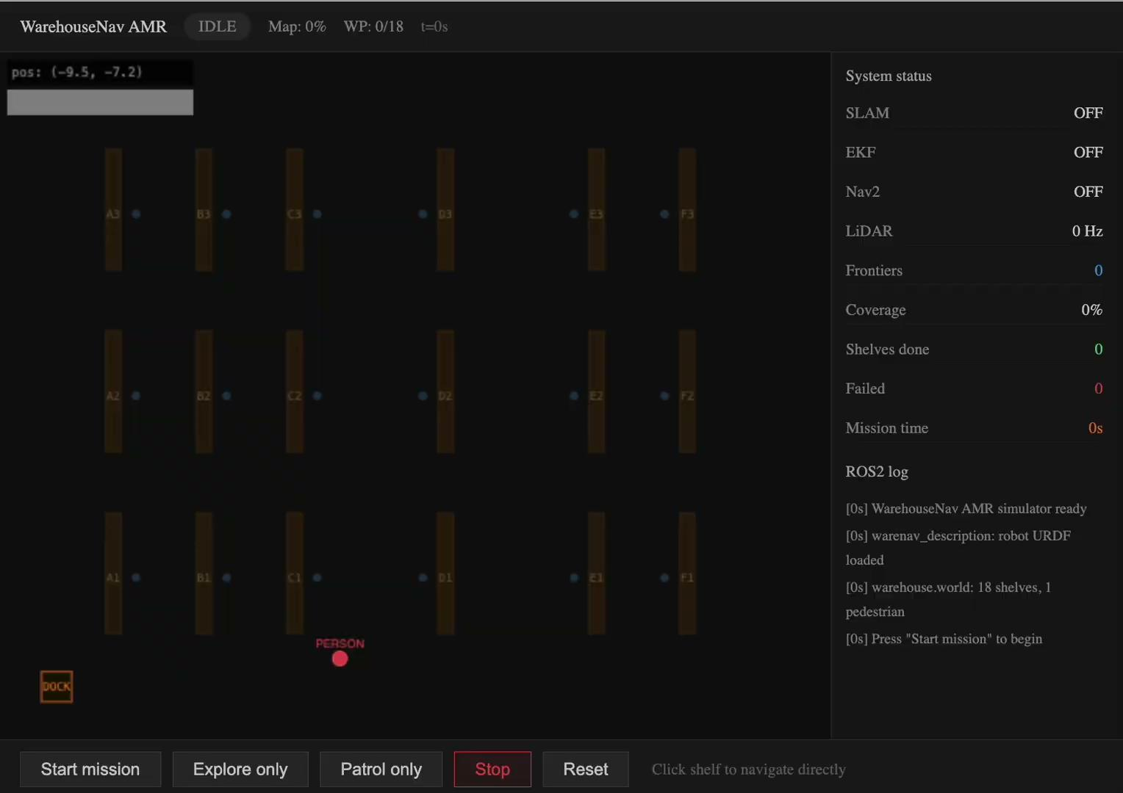
Our Final Output for the Event

